Slide 1
Women in Society
By: Janette Vidal,Daisy Martinez,Karen Martinez, Jessica Bermudez & Gabriela Andrade

Slide 2
Afghanistan's Women after 'Liberation'
Women in Afghanistan lack of natural rights and are not allowed to live freely they have very little in the say of how they want to live. Females are forced to live a certain lifestyle such as being married and underage.Since the tablan life as a female has not changed but the opportunities they have have increased, they are allowed to go to school to get a education, be employed, and receive health care, but is restricted by the Kabu and Husbands. THe rate of females being sexually assaulted increased dramatically as well and nothing has been done to prevent this not even the government. Females are waiting to rebel and speak up because they feel the need a strong county and democracy.

Slide 3
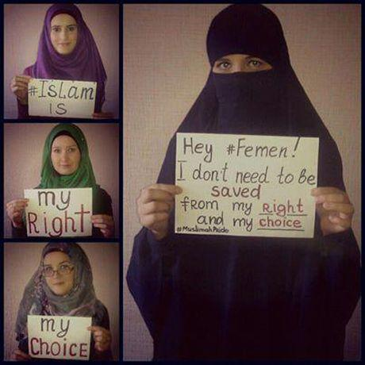

Slide 4
Afghan women fear for the future
How have things changed/stayed the same since the Taliban lost power?
Life for many Afghan women improved dramatically with the fall of the Taliban.
Explore how women’s role in society has developed in the last forty years.
Few would argue that improvements have been made in women's rights in the last decade. On a recent visit to the UK, Hussan Ghazanfar, Afghanistan's minister for women's affairs, outlined the progress made: 57% of women and girls now go to school, and 24% of health sector workers and 10% of the judiciary are female.
What challenges do modern Afghan women encounter? How are these similar/different to their mothers?
The situation of women is a disaster. Men and women today are squashed between three enemies – the Taliban, the warlords and also the occupation forces who are bombing from the skies and killing civilians, women and children. Now the Taliban are being invited into the government – there is no question the situation of women will be more disastrous and more bloody.” This is similar to their mothers because they went through the same thing.

Slide 5
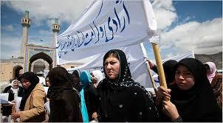
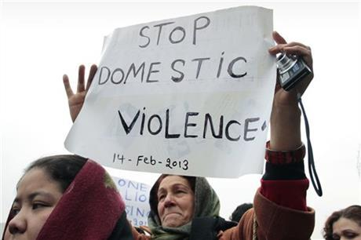

Slide 6
Women of Afghanistan Under Threat
In the images shown in the website, it showed how women were mistreated in society. A women was disfigured after fleeing from her husbands home. Women are now running for parliament. After all of the things they have gone through, women are gathering to work together so that they will no longer get mistreated. They are sticking up for eachother cause that’s what we do. We are all like comadres always having each others back.

Slide 7
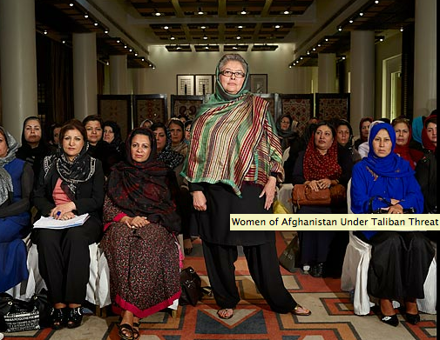
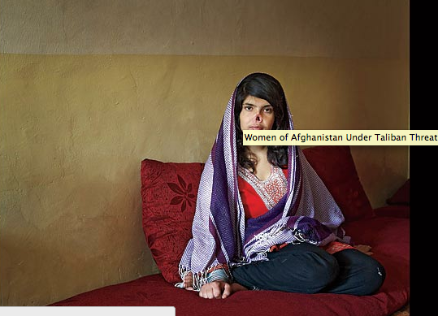
Women disfigured on the right
women having conference above.

Slide 8
Afghan Women Soar to new heights
Video
https://www.youtube.com/watch?v=oN17LOmlqYk

Slide 9
How have things changed/stayed the same since the TALIBAN lost power ?
•Since Taliban rule for at least 10 year and then lost all of his power woman were now allow to join the Air force and help defend their country along with their male compatriots
•Some of the things that remain the same were the Rules male or female both should all follow and obey the rules no matter what .
How many woman role in society have developed in the last
Forty years ?
•Five women have already graduated from a 20-week basic military training and that’s a lot for them because they weren’t allow back then. So from these five women they have encourage some of the woman who live in Afghan to joying the air force and to never give on their life goals.
What challenges to modern Afghan women encounter ? How
Are there similar / difference to their mother ?
•Some of the encounter this women face in Afghan are that they have to speak
English before moving on to more pilot training. They also have to go against
their religion because their religion rules don’t let women do or go anywhere
but to stay home with their families.
•They are different from their mother because they were capable of going to the air force. Also their mother wouldn’t betrayed their religion or faith.

Slide 10
Women suffering in Afghan
Afghan women suffer from poverty, war, and tribalism. Afghan women have to start fighting for their lives so that they can survive. Women in Afghan go through a lot of pain such as being beaten by their own husband. If they try escaping they can be abused and maybe get their nose and ears slashed off.

Slide 11
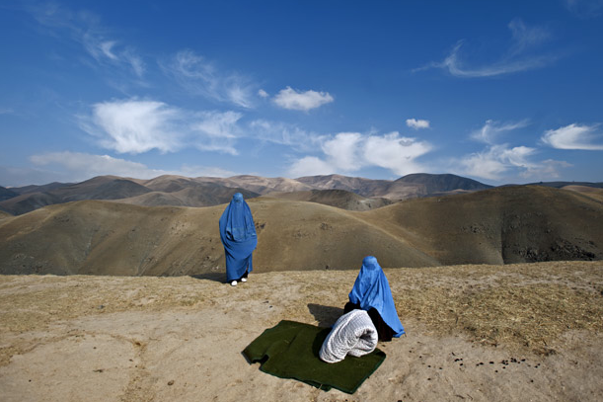
In the picture above there is Afghan women trying to escape before getting caught. They are trying to live a better life.

