Slide 1
Tribal Relationships & Family-Kite Runner
By: Savannah Noda, David Hernandez, Citlali Patino, Kathy Garcia, & Carlos Morales

Slide 2
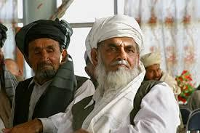
What role do tribes play in Afghan culture? Family?
The Pashtun tribes play several important roles in Afghan culture. A few of their responsibilities are,
To provide protection
Financial support
Resolvement
Give punishment to those who have committed crimes, or someone who has broken tribal rules of conduct

Slide 3
On what cultural values does the Pashtunwali code place most importance?

Slide 4
What is Pashtunwali Code?
It’s basically a set rules/laws that the Pashtun tribes must follow. The code places a huge importance on equality and peace because it creates a stabilized and peaceful culture.

Slide 5
Three most important codes
Melmastia
Hospitality is one of the Pashtuns finest virtues, they welcome anyone into their home regardless of their past relation with a smile. They then cook their guest one of their finest meals.
Badal (Eye For An Eye)
Self Respect and sensitivity to insult; To have dignity, honor, and refuse to submit to an insult. Insult leads to an insult and murder leads to a murder.
NANEWATEI
Forgive and forget; To forgive all your enemies so life can continue on peacefully

Slide 6
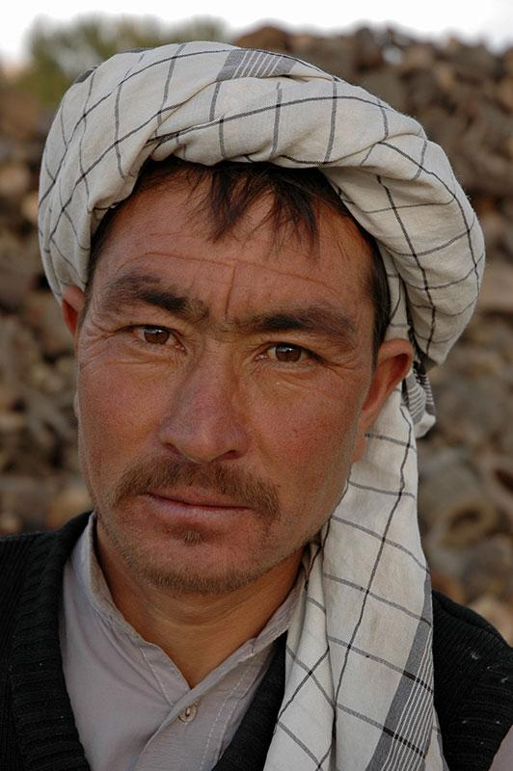
What does it mean to be an outsider in Afghan society? Why are people excluded? What does this exclusion look like?
Taking up about 20% of Afghanistan's population outsiders or Hazaras as the locals call them, are widely discriminated by the Pashtuns and other groups. There are many things that set Hazaras apart from others some of these things are :
physical traits such as: narrow eyes, flat noses and broad cheeks
geography: many outsiders are residents of Hazarajat - an isolated region in the heartland of Afghanistan
beliefs: Hazaras are primarily muslim

Slide 7
Exclusion
people in afghan society are simply excluded because of their lineage or being descendants of mabe what’s considered dirty blood. The story goes that genghis khan had invaded the land and upon death the new ruler did not rule all too well. The soldiers of genghis khan being mongols descended on its people and raped and married people of that land. Their children being the ones we see today who have what can be defined as pretty similar traits of that of mongols.

Slide 8
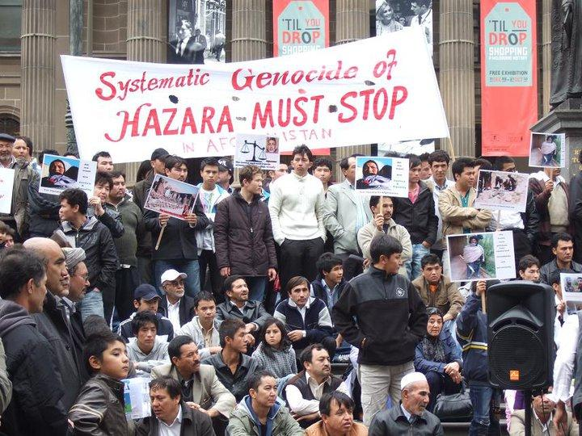
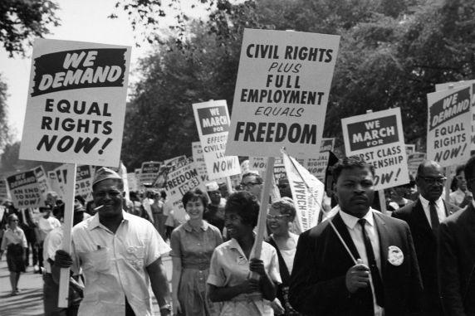
How is treatment of Afghan “outsiders” similar/different to other cultures’ history of oppression?
The treatment of outsiders or hazaras in Afghanistan can be compared to the treatment of african americans in our nation’s history. For example, back then african americans got lower wages and the “unwanted” jobs just like Hazaras nowadays. Both groups of people also suffered from segregation, less rights and overall discrimination .

Slide 9
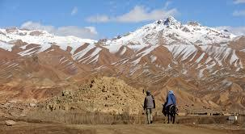
Geography of Afghanistan
Afghanistan is a landlocked asian country of 251,825 square miles, bordered by Pakistan.
the land is mixed of high lands, plains and foothills.
The climate is dry and hot, while the winters are cold with heavy snow fall.

Slide 10
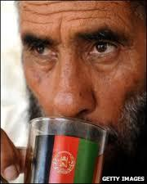
Daily foods in Afghanistan
Flat bread cooked on an iron plate in the fire or inner wall of a clay oven.
Meat is only eaten from animals that are slaughtered according to Islamic law.
A common dish is scrambled eggs prepared with tomatoes and onions.
Beverages
The people of Afghanistan drink all day
Water is also a daily drink.
Buttermilk

Slide 11
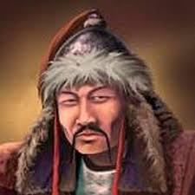
“outsiders”
“outsiders” as they are called to be seen often were killed simply for being different. Aside from similarities to that of african americans you can closely relate them to that of perhaps jews as they were persecuted or even native americans in the arrival of conquistadors. In just over 4 days 170 or more “outsiders” were killed for simply being themselves.

Slide 12
“Pashtuns”
Pashtuns is the largest and most politically powerful ethnic group Afghanistan.The Pashtuns society is composed of tribes and clans which were rarely politically united.The language that the Pashtuns speak is Pashto - indo-european language.The Pashtuns society is not homogenous by religion, they are muslim. Their culture is based on a behavior code that determines social order and responsibilities.It regulates all aspect of Pashtuns life, including tribal affairs and individual behavior.The rules of their society is honor,solidarity,hospitality,mutal support,shame and revenge.The central element is honor, and every pashtuns must defend it. Every man must protect women and land.Women marry only other Pashtuns who belong to their group or to groups that have a higher status in the society.

