Slide 1
Tribal Relationships
Ashley R. Tiffany L. Keiri L. Alexis A. Amparo S.

Slide 2
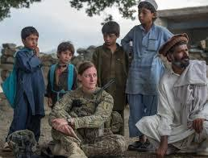
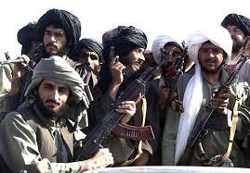
The Outsiders
The article is saying that the outsiders (hazara people) can be the only hope Afghanistan has.The Talibans, in March 2001, finished Bamian and they have not recovered since.
Talibans

Slide 3
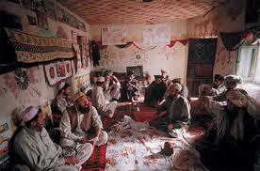
For You a Thousand Times Over
In the article it says that there are two major groups, the Pashtuns and the Hazaras. The most powerful group is the Pashtuns, they are the highest people with power. A pashtun man has to defend his wife, his children and his household. Woman marry within her ethnic status, while a male marries within their group or below it.
The Hazaras are the lowest group in the social structure. The have jobs that most people wouldn’t take up. Men build up their reputation and try to build class for themselves. Hazaras depend on their fields and crops.

Slide 4
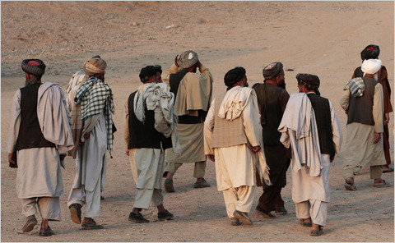
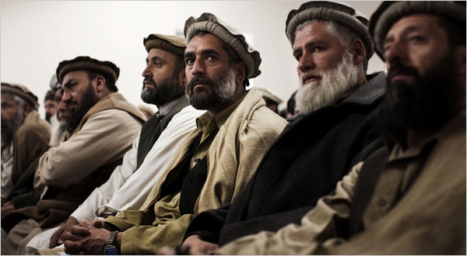
A Look at America’s New Hope: The Afghan Tribes
Tribes are very important in the Afghan Culture, used for protection for those in the tribe, financial support, and to resolve disputes.
Americans are using these tribes as allies to help bring down the Taliban.
Although many Afghans agree with the tribes and like them some Afghans believe that tribes are out-of-date, sexist, and corrupt.

Slide 5
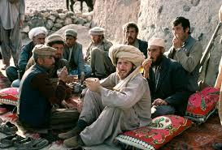
Pashtunwali Code
hospitality-pashtun great guest with a broad smile and were delighted to have guest regardless of their past relation and acquaintance
revenge- an eye for an eye
equality-everyone is equal, the pashtun have a balance in power in tribal areas
protection-the jobs of the stronger tribe was to protect tribes that aren't so powerful

Slide 6
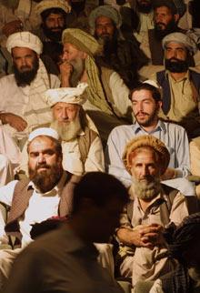
Honour among them
In the article it describes a cinema hoarding in Peshawar’s Khyber, this film raises many difficult questions of moral equivalences.
Some ways ways to slight a Pushtun’s nang is involving gold, woman or land. Pushrun embraces two obligations which offer hospitality to anyone needing it.
Many Tajiiks, like Pushtuns would die before suffering slight, but they don’t fear anything.
One reason Pushrunwaii is so durable and harsh because of remoteness; A ruined capital or two lies buried in most of its 34 provinces.
Another reason is rude health that lies un the nature of Pushtun society.
A third factor of promoting Pushtunwaii is one of its most appealing features is egalitarianism. Leadership is rarely inherited among the Pushtuns. It is above all political function that makes them so resistant to change.

