Slide 1
Period 4
#5 Vocabulary

Slide 2
acquiesce
To accept the conclusions or arrangements of others; to accede; to give consent by keeping silent.
The potential investors of Banana Inc. had acquiesced the new software release expectations from the CEO of the company.
Sam and Crystal

Slide 3
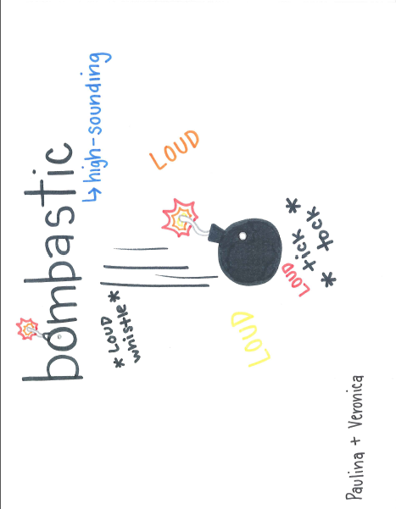
bombastic

Slide 4
capitulate
1. Capitulate: To surrender; To cease resisting- The knights had decided to capitulate after the terrorist started to take the towns peoples' children.
Airam

Slide 5
deflate

Slide 6
egregious

Slide 7
Fitful
Fitful – coming, appearing, acting, etc. in fits or by spells. Recurring irregularly (spasmodic). Interrupted.
I had a fitful sleep filled with many muscle spasms from my basketball weightlifting session.
Jakob

Slide 8
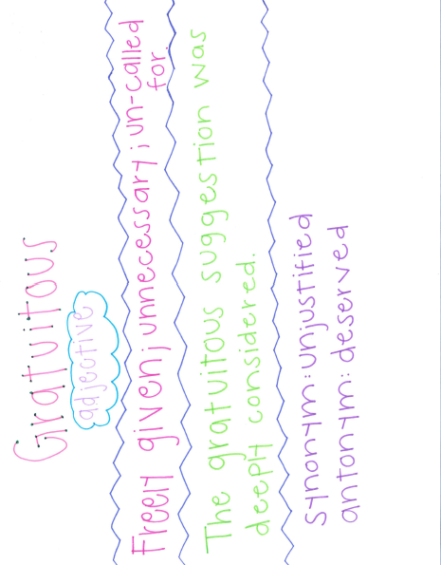
gratuitous

Slide 9
hierarchy

Slide 10
Impartial
impartial– fair; just; showing no favoritism.
Although the drawing was impartial, the man felt as if he was cheated because he lost.
Synonym: Neutral Antonym : Biased
The woman was neutral in the case even though it was her own son being convicted.
imparcial ; El abogado fue imparcial en el caso de el hombre aunque el lo trato de comprar.
( image is showing a impartial choosing of numbers )

Slide 11
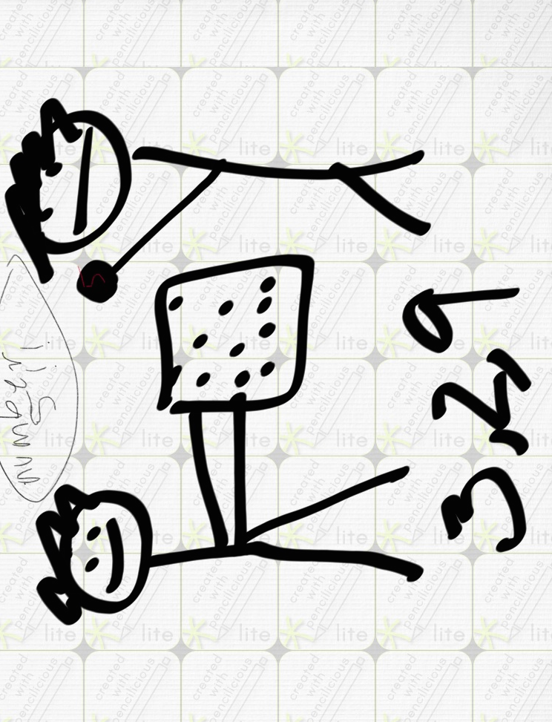
Impartial

Slide 12
lassitude
Lassitude: (n) – state or feeling of being tired and listless; weariness.
She couldn’t shake the feeling of lassitude as she ran the last mile.
Rebecca and Kiara.

Slide 13
meticulous
Meticulous: very careful about details; fussy.
He’s very meticulous about picking the right song.
Bryan Z.

Slide 14
opportunist
Opportunist - one who takes advantage of any opportunity without regard for moral principles
sentence - Javier is an opportunist when it comes to hitting a dirty player in soccer.

Slide 15
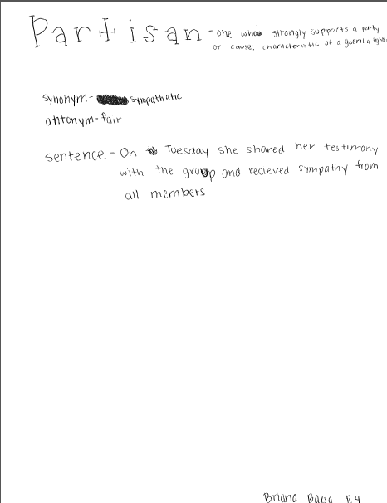
partisan

Slide 16
raze

