Slide 1
Period 1
#5 Vocabulary

Slide 2
acquiesce
acquiesce; verb – to accept the conclusions or arrangements of others; to accede; to give consent by keeping silent.
Synonym: agree
Antonym: disagree
Jonathan and I can never acquiesce on who gets to have their birthday party first.

Slide 3
bombastic

Slide 4
capitulate

Slide 5
deflate
partisan; noun – on who strongly supports a party or cause; characteristic of a guerilla fighter. A partisan of the animal rights cause, John believes all use of animals for testing should be banned.
-Synonym: supporter,follower, adherent, devotee
-Antonym: fair, unbiased, disinterested
Sentence using synonym:
Ashley is a supporter of the Gay Straight Alliance at Stern Mass.

Slide 6
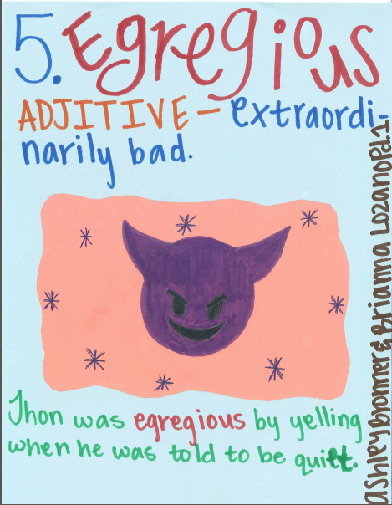
egregious
Ashley B & Brianna

Slide 7
Fitful
Fitful; adjective- spasmodic; intermittent.
Sentence: A synonym for the word fitful would be irregular.
Synonyms: irregular, random, fragmentary, etc
Antonyms: continuous

Slide 8
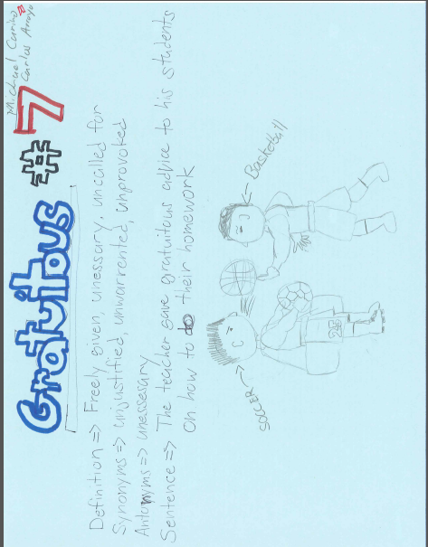
gratuitous
Michel & Carlos

Slide 9
hierarchy
Emely Medina, Karlene Garcia, Bianca Trevizo
Hierarchy: organization by rank, class, or grade
Sentence: The school system can be referred to as a hierarchy because many students are split up into different classes depending on their rank and/or grade level.

Slide 10
Impartial

Slide 11
lassitude

Slide 12
meticulous

Slide 13
opportunist
Opportunist: noun- One who takes advantage of any opportunity without regard or moral principles
The opportunist man took the money that was found in the bag across the street from a bank.
Andrew Zavala and Abram Jimenez

Slide 14
partisan
partisan; noun – on who strongly supports a party or cause; characteristic of a guerilla fighter. A partisan of the animal rights cause, John believes all use of animals for testing should be banned.
-Synonym: supporter,follower, adherent, devotee
-Antonym: fair, unbiased, disinterested
Sentence using synonym:
Ashley is a supporter of the Gay Straight Alliance at Stern Mass.

Slide 15
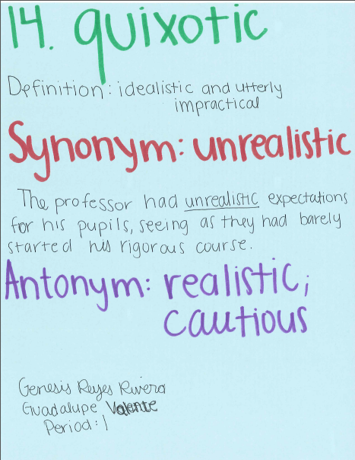
quixotic
Genesis R.

Slide 16
raze

