Slide 1
Kite Runner Pt.2
Khaled hosseini

Slide 2
The taliban

Slide 3
How does the Taliban relate to the story?
In the beginning of The Kite Runner, the monarchy is still in place and the country is relatively calm. However, chaos starts to erupt as the king is overthrown by his brother.
In the second half of The Kite Runner, the Taliban is in power, creating a much more volatile and dangerous Afghanistan.

Slide 4
The Taliban
Predominantly Pashtun/Sunni movement – struggled to gain power after Soviet Union (1989) leaves Afghanistan.
Afghans were tired of political groups fighting for power after the Soviet power vacuum, welcomed the Taliban’s structure.
Taliban promised to restore peace and security by enforcing “sharia” (Islamic law).
Introduced Islamic punishments (punishments outlined in the Quran (holy book)).
Attention drawn to Taliban after World Trade Center attacks on September 11, 2001.
-accused of providing Osama Bin–Laden sanctuary (leader of
Al Qaeda movement).
The US led a “War on Terror” that drove the Taliban from power in Afghanistan after 9/11. Taliban hid in mountains and Pakistan.

Slide 5
Taliban Rules for Women
May not work outside the home.
May not participate in any activity outside the home unless accompanied by her husband or male relative.
May not be treated by male doctor.
May not study at any institutions, including schools and universities.
Must wear the long veil (burqa) which covers them from head to toe.
If found guilty of adultery, will be publically stoned to death.
May not laugh loudly – no stranger should hear a woman’s voice.
May not wear high heels – no man should hear a woman’s footsteps.

Slide 6
Taliban Rules for Everyone
No one can listen to music.
No one can watch television, movies or videos.
No citizen can have a non-Islamic name.
Men may not shave or trim their beards.
No one may fly kites.
In any sporting event, no one may clap.
Anyone who converts from Islam to any other religion will be executed.
No burying of anyone who was killed by the Taliban. Bodies must remain in the streets as examples to other ‘wrongdoers’.
Source: Amnesty International USA The Kite Runner Companion Curriculum. http://www.amnestyusa.org/education/pdf/kiterunnerhigh.pdf

Slide 7
Think-Pair-Share for last 2 slides
With your neighbor discuss the following:
1. What are 3 rules of the Taliban for everyone.
2. What are 3 rules for women?
3. Do you think these rules are fair? Explain.
4. Would you be able to follow them?

Slide 8
Islam background

Slide 9
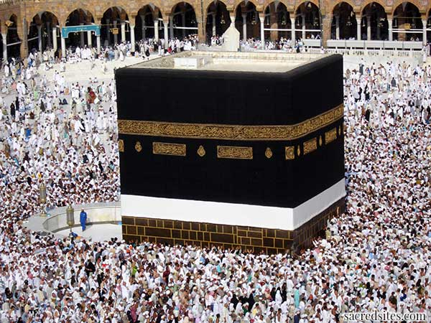
Islam
A religion based on the interpretations of God’s word by the prophet Muhammad found in the Qu’ran (sometimes spelled Koran).
Monotheistic (one God). Arabic word for God is Allah.
Jesus, Moses and Abraham are prophets. Final prophet was Muhammad.
Followers of Islam, Muslims, are devoted to daily prayer (five times a day facing Mecca, the holy city)

Slide 10
The Tenets of Islam
Tenet (n): a principle or belief, esp. one of the main principles of a religion or philosophy.
There are several tenets of Islam, but there are three mentioned early on in the book:
Zakat – charitable giving
Hadj – pilgrimage to Mecca
Namaz – five daily prayers facing Mecca

Slide 11
Divisions of Islam
Islam is divided into two denominations, Shia and Sunni.
The Pashtun (majority) are typically Sunni, and the Hazara (minority) are typically Shia.
Ethnic differences are compounded by the religious differences.

Slide 12
Pashtun words used in tkr
jan – a term of endearment often used after a person’s name: Baba jan
agha – leader, ruler, master, lord
sahib – friend (original), lord
naan – bread

Slide 13
Tkr Main Characters
Amir – the main character; narrator
Baba – Amir’s father; wealthy Afghani
Rahim Khan – Baba’s best friend and business partner; an uncle to Amir
Hassan – Amir’s best friend; servant
Ali – Hassan’s father

Slide 14
Major Themes of tkr
Betrayal and Redemption: Betrayal, which can be considered a form of sin, is long-term and ends up being cyclical in The Kite Runner.
Forgiveness: What does it mean to truly forgive someone, but most importantly to forgive yourself. The idea that “God will forgive” those who ask for forgiveness.

Slide 15
Themes Continued…
Powerlessness of social class, ethnicity, gender, intellectual, religious expression.
Immigrant Experience in America: the adjustment to a new country is not just about learning a new language; it is about maintaining traditions and some semblance of your own culture (Holding on to culture).
Relationship Between Fathers and Sons: The relationship between Fathers and Sons can be manifested in the parent and child relationship, but also in a substitute parent when you do not have your Father figure.

Slide 16
Themes…
Standing Up For What Is Right: Doing the “right” thing is subjective to your personal beliefs, society, and/or religion. Standing up for what is right is not always the popular thing to do.

Slide 17
The End!
Congratulations, you survived!! ;)

