Slide 1
Women in Society
BY: Emely Medina, Bianca Trevizo, Ashley Bronner, Karlene Garcia, Esmeralda Magaña, Genesis Reyes

Slide 2
Women of Afghanistan Under Taliban Threat
Women under Taliban Threat - TIME Photo Essay
Women who were successful in the past are in danger of being sidelined, and may lose their power in parliament, because of new election rules in Afghanistan
Women in Afghanistan are sold into marriage at young ages, and have no means of escape
Women are so oppressed, oftentimes they resort to suicide to escape the oppression
Women in Afghanistan can be imprisoned for crimes that are not ascribed to men, such as running away from husbands, and adultery
Running away resulted in a woman having her nose and ears sliced off by her own husband, and brother-in-law. She was then left to die.
Children all over Afghanistan have lost parents and siblings to the war in Afghanistan
Younger generations of Afghan women are no longer required to wear burqas; they want more liberal and open ways of living in Afghan society
many women still wear them out of tradition or fear
Despite the oppression, women have made huge progress in Afghanistan
not compared to other countries, but compared to Afghanistan back in 1920

Slide 3
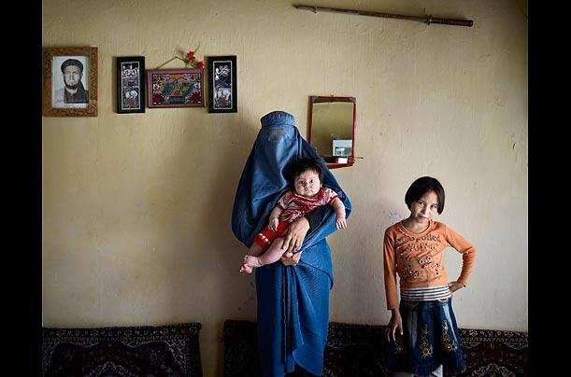
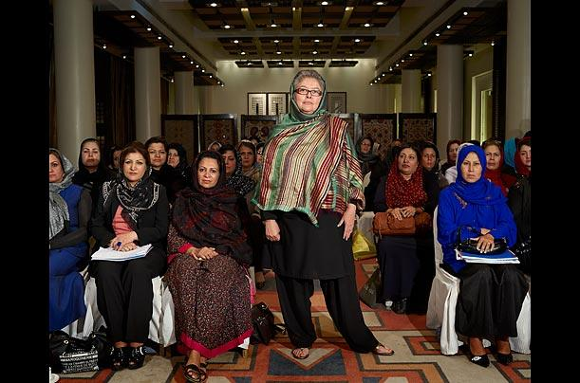
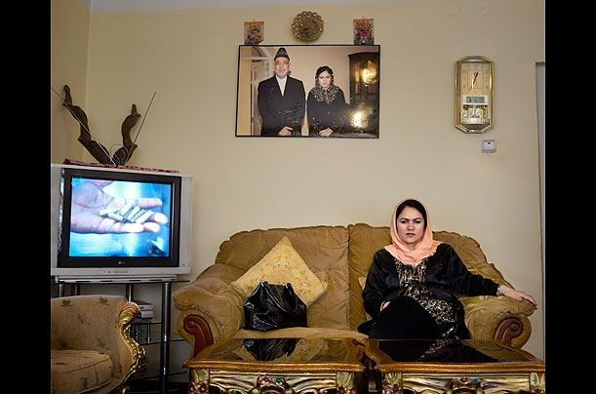

Slide 4
Afghan women fear for the future
An Afghan woman who was married at 15 and divorced by 16 was banned from working and leaving her house unaccompanied
This year will see the 10th anniversary of the US and UK's military intervention in the country
This, fear Afghan women, could mean a reversal of all the hard-won improvements of the last few years
57% of women and girls now go to school, and 24% of health sector workers and 10% of the judiciary are female
Ghazanfar admits: "Life is different in the countryside – the literacy level is different, traditional customs are stronger, and women have no financial or economic freedom there."
The Taliban are a group of people who set out to kill and remove women’s rights
Then there are the honour killings and the fact that women and girls who run away – to escape forced marriages or violence – are often arrested, prosecuted and imprisoned, usually under a charge of attempting to commit zina (sex outside marriage

Slide 5
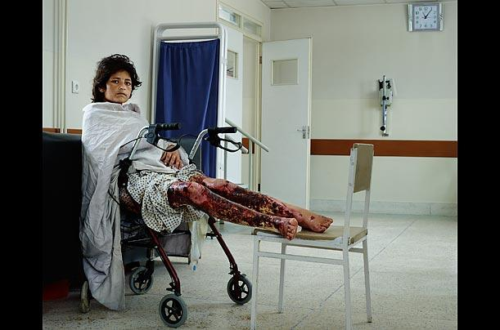
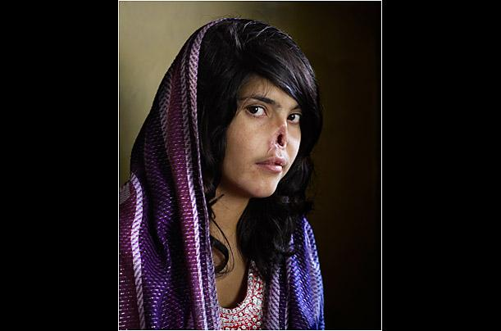

Slide 6
National Geographic overview with photo gallery and linked video
In Afghanistan husbands beat and treat their wife’s poorly. Women have to act the way their husband wants them to our they are beat. Men will cut off their wife's ears and nose as punishment. Women try to run away from the abuse and get away there are place the can find that can help them. If there husbands find them when they run away they will have worse punishments. If they do get away it is a miracles. Pashtun is know as the way of life that has taken over since the war. It is organized around the code known as Pashtunwali, the "way of the Pashtun." The foundation of Pashtunwali is a man's honor, judged by three possessions gold land and women. The principles on which the honorable life is built on hospitality shelter and justice.

Slide 7
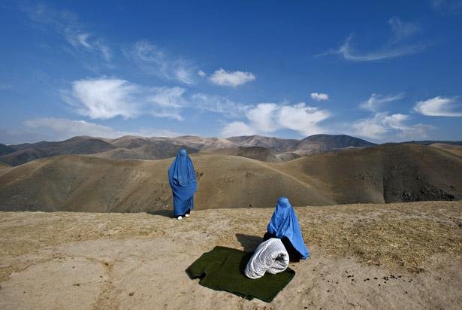

Slide 8
Afghan Women Soar to New Heights
The Afghan Air Force can now count on women to help defend their country along with other males
Before, women’s rights in Afghanistan were brutally restricted under the Taliban rule
Taliban rule: an Islamic fundamentalist group that seized Afghanistan which went into totalitarian dictatorship and gender discrimination in which women and girls were stripped of their basic human rights
Five female lieutenants have been preparing for careers as pilot officers in Afghanistan’s air force
It is a dream and a privilege for these woman who once did not have rights
These five women had to learn english as they competed skills with other men
It is an honor for the women as they continue to be ranked

Slide 9
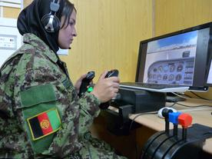
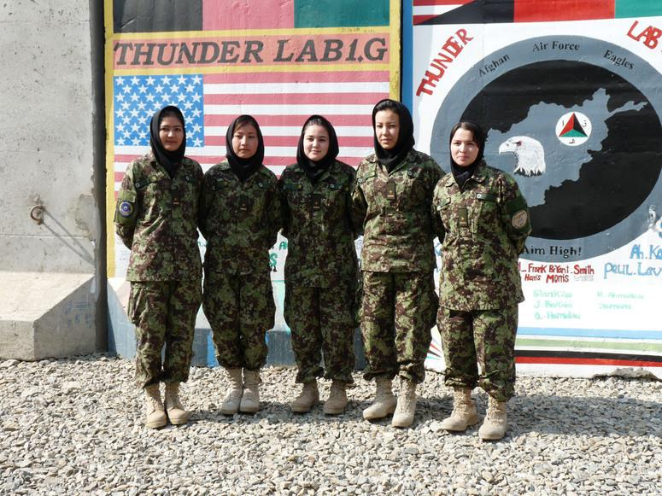
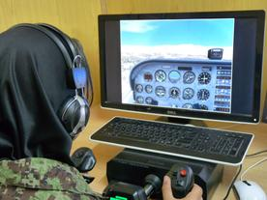

Slide 10
Afghanistan's Women after 'Liberation'
Women can not speak out about their rights because then they will be in danger
The women are waiting to be able to speak about how they should be treated
The government has not changed very much since the taliban were stopped
Women can go to school, but can not go into high school due to young and arranged marriages
If they report rape or assault they are put in a jail “for their protection” but in reality it to show that if you report a man for his abusive behavior then you will go to jail
Women are still wearing their burqua ( a long piece of clothing that cover the woman's body from head to toe) to avoid humiliation
womens schools have been burned down because they see it as wrong
women have to be at the hand and feet of their husbands doing everything they ask

Slide 11
Associated article with preceding photo essay
Women are brutally punished by their own husband and his family members if women try to escape
Peace is achieved by sacrificing women
Women are hidden in a secret women's shelter in Kabul for protection.

Slide 12
How have things changed/stayed the same since the Taliban lost power?
The women get to go to school, but are still not accepted for a full education
they are still afraid of getting rapped or beat
they still don’t have any rights and are forced to be at the hand and feet of their husband
The women are still physically and mentally punished/beaten
Women remain oppressed, but have more rights than before
Things have changed since the Taliban lost power there is know a new way of life called pashtunwali.

Slide 13
Explore how women’s role in society has developed in the last forty years.
Women are married off at young ages
Things have changed since the Taliban lost power there is know a new way of life called pashtunwali.

Slide 14
What challenges to modern Afghan women encounter? How are these similar/different to their mothers?
they still wear the same clothes as their mothers because they feel unprotected
can not go to the police if assaulted because then they will be in jail “for their protection”
are still forced to marry/ young marriage and be at the hand and feet of their husband
They are no longer forced to wear a baruq
Women are still sold into marriage
Running away from a marriage is still illegal, and punishable with prison time and physical abuse

Slide 15
What is the name of the Afghan group who violently removes rights from women?

Slide 16
Why are women sacrificed to achieve peace?

Slide 17
Why do women still wear a burqa? Do you think women should feel this way?

