Slide 1
Kite Runner: Daily Life
Bryan Zamora, Emily Najera, Leslie Vasquez, Karina Rodriguez & Airam Perez

Slide 2
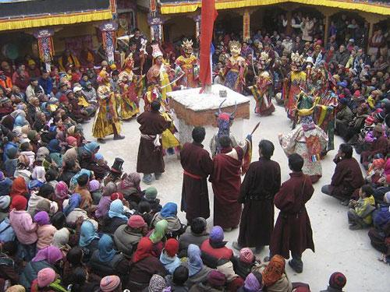
Basic Cultural Overview
Afghanistan is multicultural and multiethnic. They flatbread cooked on an iron plate in the fire daily. Dairy products are an important element of their diet. Even though prefer mutton meat, they also eat chicken, beef, and camel. However, on special occasions they eat rice meat, carrots, raisins, pistachios, or peas. Agricultural land is owned privately, while irrigation canals are shared. They trade hides wool, dried and fresh fruits, and pistachios. However, they have no industrial activity, because of the war. Most of their workers are young unmarried males, since females aren’t looked as the males equals. As long as one is able do the work, then they are able to do so. There is a big difference between the wealthy and the poor. Some groups are egalitarian while others have hierarchical social organizations. Their government is recognized only by Pakistan, however they have no unified government. They apply a tribal-based conception of Islam. Those who commit adultery and consume drugs are severly punished. This means they can be beaten, amputated, or be sentenced to public execution Some are jailed without trial by the various factions. The males and women are differntaited, which means that the males do the labor work, while the women do the house work. KIng Amanullah tried to promote female empowerment in 1919 and 1929, however it was reversed by the Taliban. When it comes to marriage it is considered an obligation, and a male may have more than one wife if he treats them all equally. The property is divided up evenly amongst siblings in case of death.

Slide 3
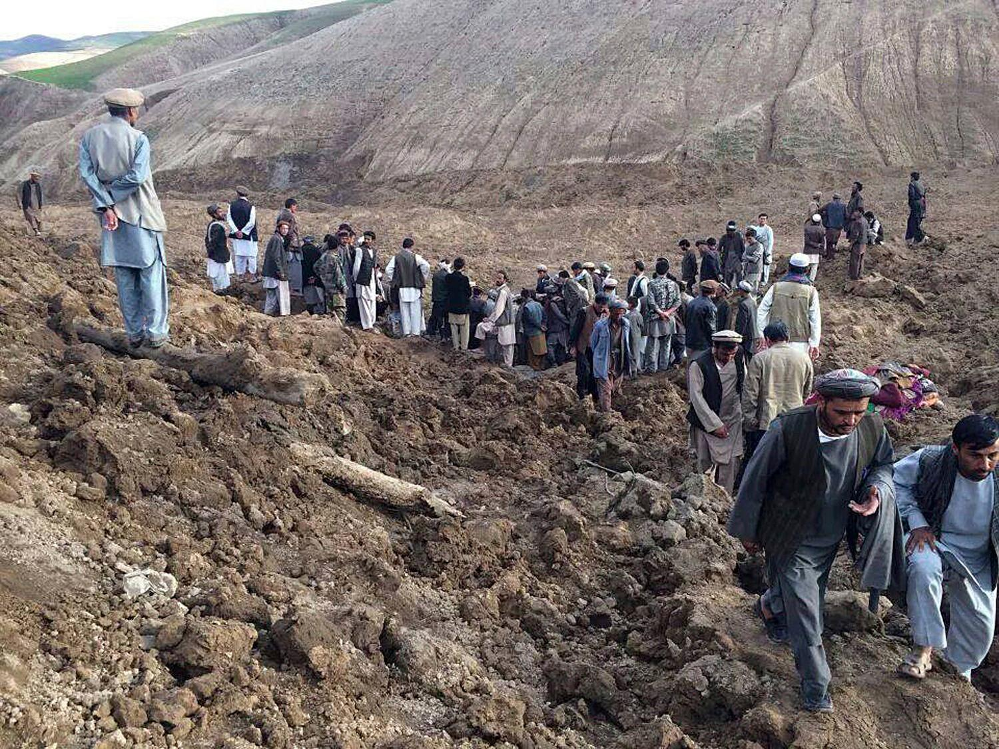
Brief Economic Overview
Karina Rodriguez
Although about 10 % of the land is not cultivated, the main occupation of Afghanistan is agriculture. Between 1980-1990 much of the land was damaged. Fruits, nuts, wheat and other grains are the most important crops. Sheep are a very important part of Afghanistan culture since they supply skins and wool are used for clothing while their meat and fat are used for food. Their economy is not so great , in 2005 there was about 40% unemployment rate. Many of the roads are in poor condition. Much manufactured goods are an important part of the imports, Afghanistan has even become a great producer of heroin. Their main trading partners have been Pakistan, the United States, and India.

Slide 4
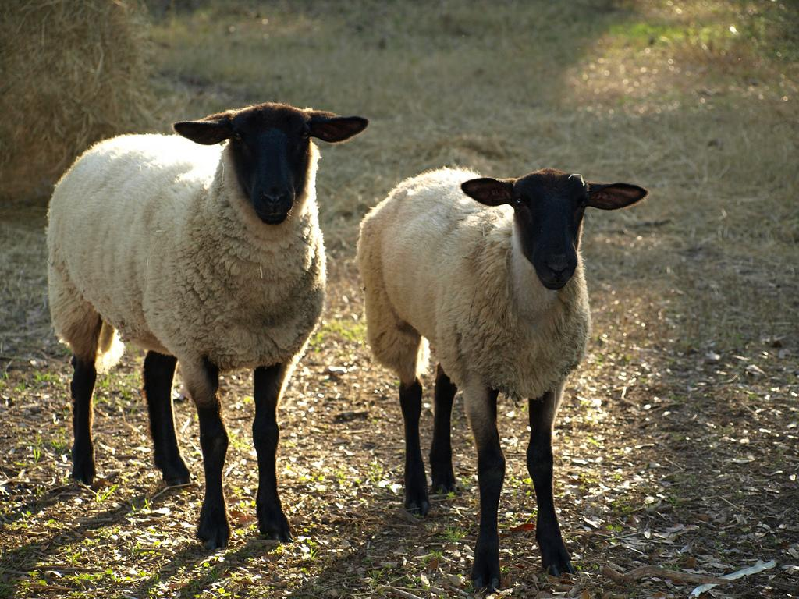
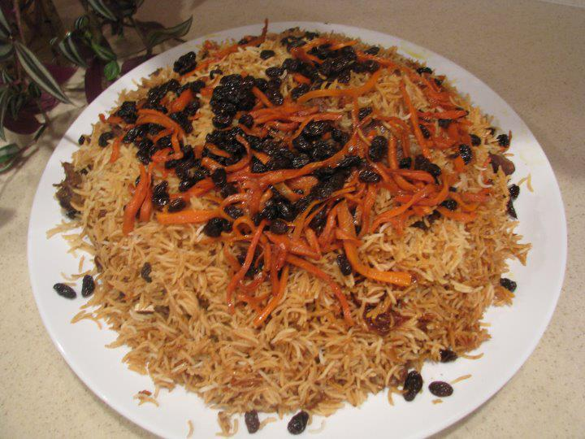
Afghanistan Food
Karina Rodriguez
Sheep are often used for food, their meat and fat are eaten. Qubli Pulao is one of Afghanistan’s most popular dish which is a lamb meat with steamed rice with a side of rains and carrots. Afghan Kofta (meatballs), Nan-i-Afghan (Afghan bread), Quroot (dried yogurt), Osh Pyozee (stuffed onions), Sher Berinj (rice pudding), Qabli Pulao (traditional rice dish), Mantu (meat dumplings), Dampukht (steamed rice) and Kababs (skewed mean chops) are some popular foods. The people treat their guest greatly and serve them the best food they can, the people are more into meaty dishes rather than vegetable dishes..

Slide 5
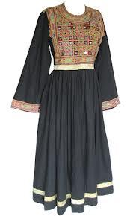
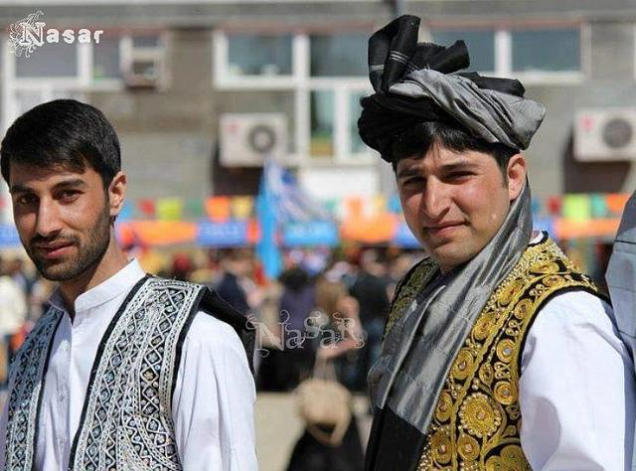
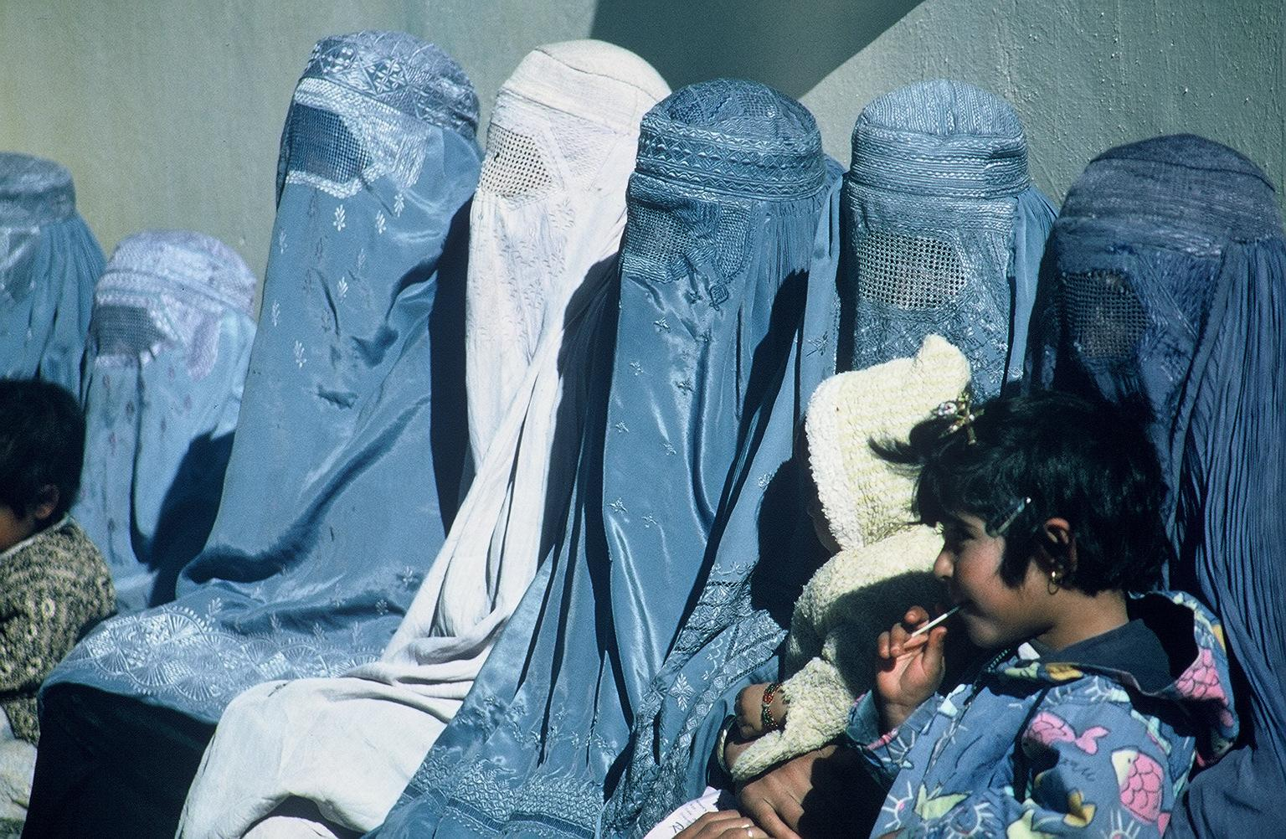
Pashtun Culture and Clothing
Pashtun culture is very conservative. Women are obliged to wear conservative clothing and respect men. Pashtun culture is moral based so if you do something wrong, you are shunned for as long as the punishers want. Women are required to hide their bodies therefore wearing a burqa, while men are more free to choose their clothing.

Slide 6
Dress code laws since the Taliban
In the article Afghanistan plans Taliban-style dress code for weddings,the justice ministry is considering to ban clothing for women that is considered semi-naked,tight or transparent. The government want to start to monitor weddings for people to follow the guidelines. The groups that will monitor have to make sure of some things like for example men and women not to be in the same rooms before the wedding and that the bride is well dressed. Some brides would not agree to the law that the government wants to pass that prevents them from wearing the dress of their dreams.

Slide 7
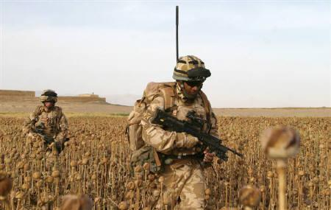
Opium Wars
The chief police is missing his middle finger from one hand, and his forearm is badly mangled. He’s received death threats, and stones have been hurled at his men. The 85% of citizens are farmers. The job of the policemen is to wean off farmers off growing poppies. The addiction to opium has to end , which is why the poppy fields must be destroyed.

