Slide 1
History and Geography
Evelyn M. Shalma V. Guadalupe V. Aylin I. Ethan O. Jonathan A. Alex M.

Slide 2
Basic Cultural Overview
Afghanistan shared religion,the relative self-governing communities, and avoided fragmentation in 1978. The majority of the inhabitants felt like they be suited to a local community. Their state wasn’t a disturbance, however their national identity was poor. After the coup of 1978, the fragile equilibrium was eradicated.

Slide 3
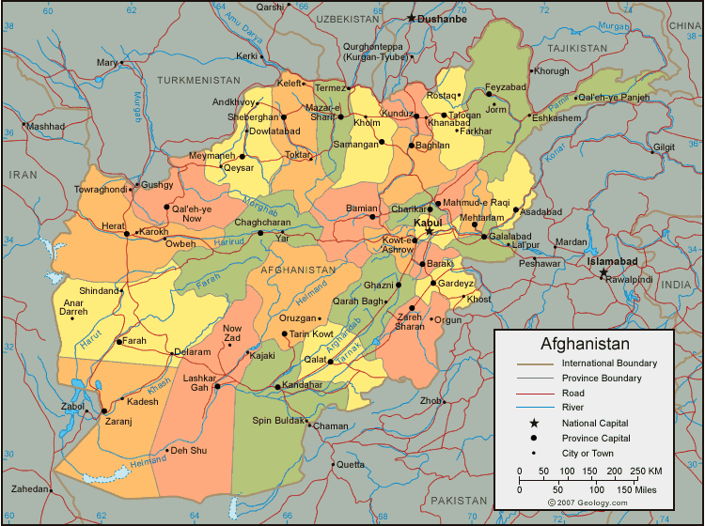

Slide 4
Basic Cultural Overview (continued)
The country's (Afghanistan) history has been dominated by internal conflict. During the 1900 century Afghanistan struggled and suffered with the colonial power between Russia and British India. In the beginning of the nineteenth century two branches of Durrani Pashtuns, eventually rulled but until the 1978.

Slide 5
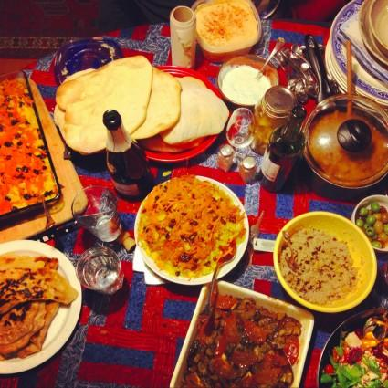

Slide 6
Historical Overview
The muslim conquest of Afghanistan began in the 7th century.Dost Muhammad became emir in 1826, the status of Afghanistan became an international problem during his rule.In 1878 the second Afghanan war began due to the russians bordering Amu Darya and Sheri Ali and British quarreling.Border agreements were reached with Russia(1885 and 1895). During World War 1 and 2 Afghanistan was neutral. The third Afghan war was ended by the Treaty of Rawalpindi.In the late 1970s Afghanistan was neutral,recieving aid from both the United States and the soviet union.1970s the country was beset by serious economic problems,particularly a severe long-term drought problem in the center and north.Group of young military officers deposed (July 1993) the king and proclaimed a republic. Country was devastated by the Afghanistan War (1979-89),took enormous human and economic toll.

Slide 7
Historical Overview (continued)
In August of 1998, u.s. missiles destroyed an extensive terrorist training complex near Kabul. In March 1999, a UN-brokered peace agreement was reached between the Taliban and their major for, the forces of the northern alliance but fighting broke out again that following July. In early 2001 the Taliban destroyed all statutes in the nation. In October 2001, following the events of September 11 2001, the United States launched attacks against the Taliban and Al Qaeda.

Slide 8
Historical Overview (continued)
The fights between Afghanistan and Pakistan continued through 2008. The president Karzai escaped an attempt at assassination and blamed Pakistan agents for it. All of these wars have contributed to the governments development. Afganistans government is weak and corrupt. This has led to the reduction of the effectiveness of aid on many occassions.

Slide 9
Historical Timeline [1999-1978]
Afghanistan has been through wars and battles with each other before and after they declared their independence in 1919. Numerous power shifts occurred for this country, leading to its rebellions and civil wars in the country that caused numerous power shifts within itself. This lead to the conflicts and weakening of Afghanistan on numerous occasions which lead to the aid of foreign nations. Occasionally, however, the country stood tall and proud while at other moments, hid in the background till it was ready to stand up once again.

Slide 10
Historical Timeline [1978-2004]
Afghanistan continues in a struggle for power and independence. Leadership is passed on from person to person causing constant power shifts while foreign nations support resistance fighters.Slowly communist power dwindles until freedom prevails.

Slide 11
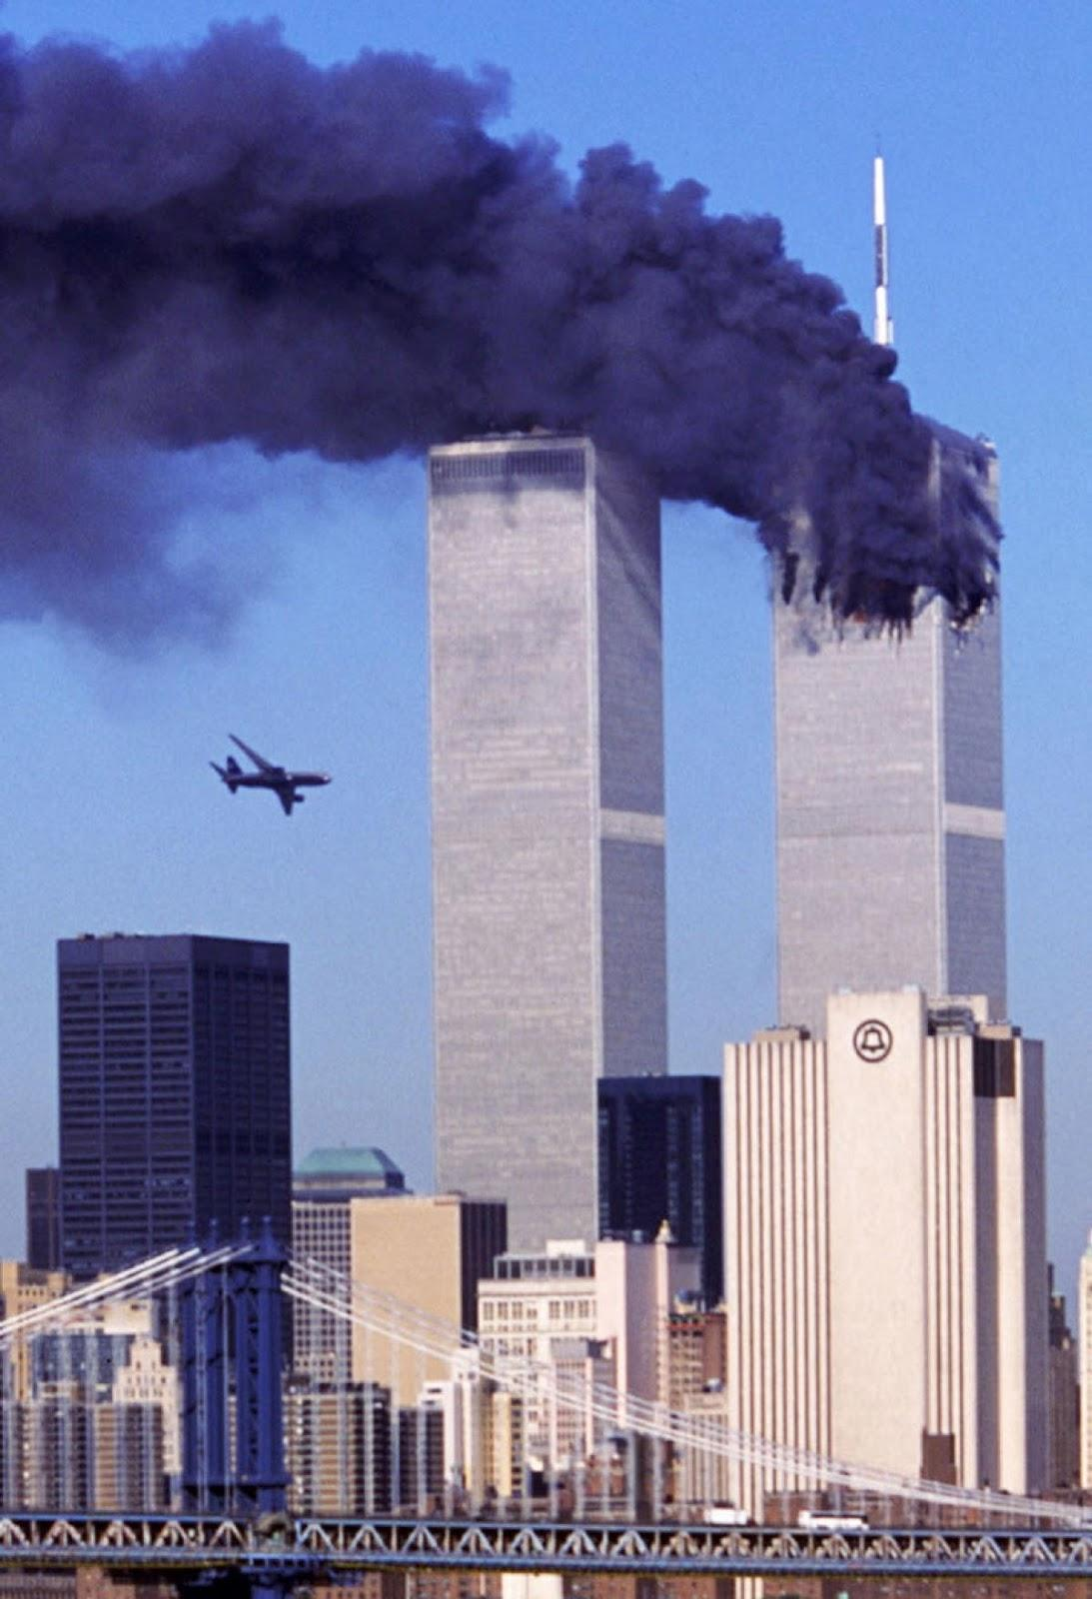
Unfortunate Disaster

Slide 12
What happens in 1921?
In 1921, Afghanistan won its third war against the British and it became an independent nation with The Soviet Treaty of Friendship, also known as Anglo Afghan Treaty, and Amir Amanullah Khon became the king of the country.

Slide 14
What happens in 1933?
In 1933, Nadir Shah was assassinated and immediately replaced by his son Zahir Shah. however, the land was still ruled by his uncles. Despite that, he managed to bring stability to the country and ruled for about forty years.

Slide 15
Who does Gen. Mohammed Daoud Khan make an alliance with? Why?
Gen. Mohammed Daoud Khan made an alliance with Nikita Khrushchev to help Afghanistan. He was the cousin of the king at the time and made the transition from a prime minister for the country to the president.

Slide 16
1973 was a pivotal point in Afghanistan’s history. Why?
In 1973, Afghanistan made a pivotal point in history because Gen. Mohammed Daoud Khan overthrew the king at the time who he did not like. It was his cousin, Zahir Shah so he took control, outlawed the monarchy and declared himself as the president.

Slide 17
Why does Osama shift his focus from the Soviet Union to the United States in 1988?
Osama shifted his focus from the Soviet Union to the United States in 1988 because he wanted to stay powerful and also wanted the country to have an influence of Islam.

Slide 18
USSR Flag

Slide 19
In 1992 Afghanistan endures yet another coup. Which group takes over this time? What are the problems with this group?
In 1992 Afghanistan endured another coup, they were taken over by the Mujahadeen “strugglers” a rebel group, who had stormed the capital, Kabul and they kicked out Najibulla, the current ruler. This occurred in the civil war and they ended up stopping the Soviet air power.

Slide 20
Why do most Afghans believe the Taliban takeover in 1993 is a good thing at first?
Most Afghans believed that the Taliban takeover in 1993 was a good thing because they had restored security within the country and conquered most of it. However, they banned television, music, movies. Girls weren't allowed to attend school and all woman had to wear a covering over themselves.

Slide 21
Why do more than a million Afghans flee to Pakistan between the years of 1995 – 1999?
Over a million Afghans fled to Pakistan between 1995 and 1999 because it seemed that the Taliban was on the verge of taking over the whole country. Also, Osama Bin Laden had been accused of bombings in Kenya and Tanzania, American embassies.

Slide 22
What was America’s answer to the attacks on Sept. 11, 2001?
In response to the attacks on September 11, 2001, America went to war with Afghanistan for the next decade.

Slide 23
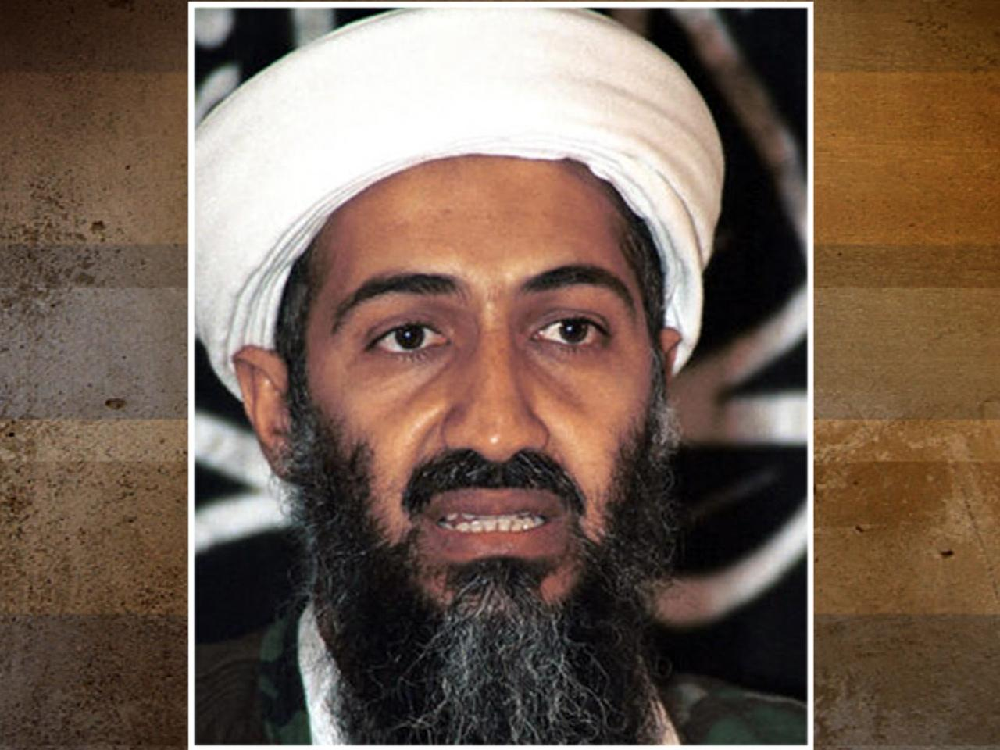

Slide 24
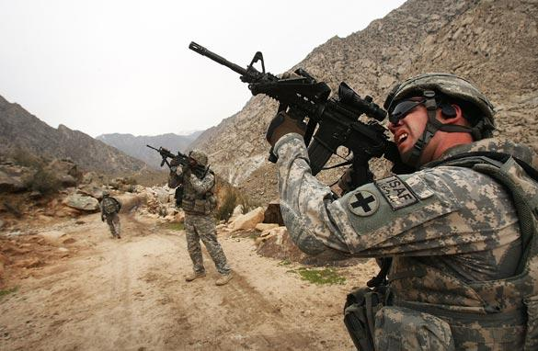

Slide 25
What trends do you see in history?
In Afghanistan history, there have been a lot of wars, civil wars and instability. Everyone has gone through a lot of trouble in this country because there are a lot of power shifts from time to time.

Slide 26
What do these suggest about life for the average citizen?
For an average citizen in Afghanistan, life is hard and long because compared to the lives of others in different places, they have a short span because of the war they face they also face commotion from the outside world as well since many of them have a bad reputation from others.

Slide 27
What do they suggest about Afghan national identity and values?
Afghan national identity, the country is a war zone that has a lot of instability with the country from the constant wars and power shifts. Many people there have pride in their country and carry on traditions throughout generations to come.

Slide 28
How does the country's "basic information" affect its national identity?
Many people who aren't from Afghanistan assume that it is a bad place with terrorist and in ruins. It has a bad connotation to Afghanistans identity which make people wary of the country and have biased opinions before things are further questioned.

Slide 29
Afghanistan Flag

Slide 30
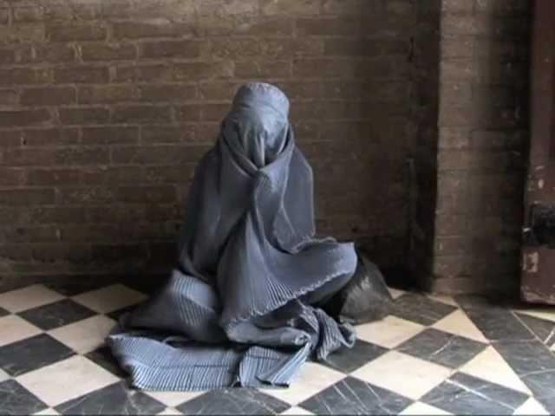

Slide 31
Discussion Questions
What were some major power shifts that occurred in Afghanistan that made the country what it is today?

