Slide 1
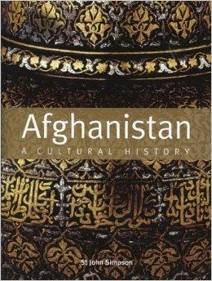
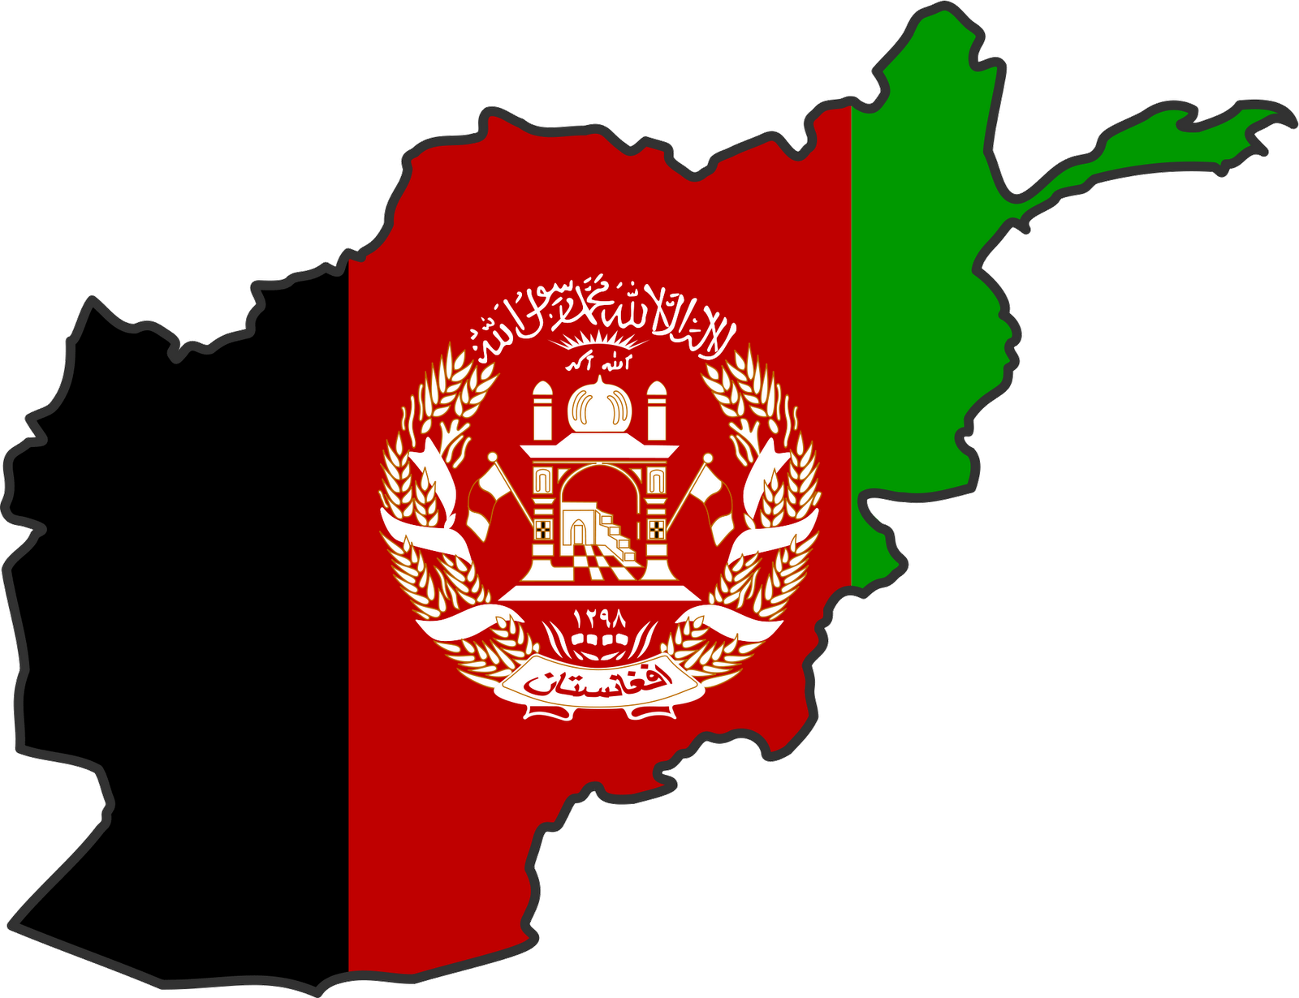
AFGHANISTAN CULTURAL CONTEXT:
HISTORY AND GEOGRAPHY
Raquel Morales,Enrique Vargas,Efrain Alvarez,Christian Mora, Jennifer Mendez

Slide 2
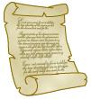
What happened in 1921?
In 1921, afghan signed a soviet treaty of friendship

Slide 3
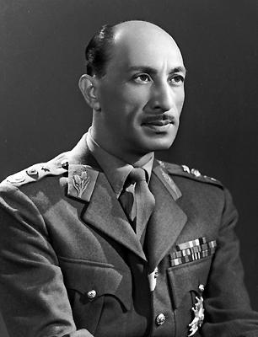
What happened in 1933?
In 1933, King Nadir Shah was assassinated and was immediately replaced by his son Zahir Khan but the power remained in the hands of King Nadir’s brothers.

Slide 4
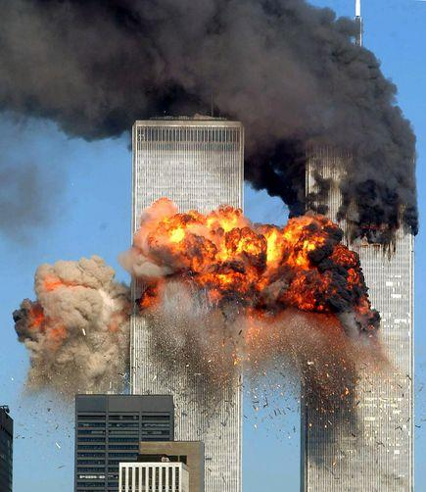
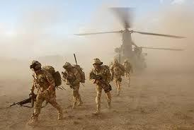
What was America’s answer to the attacks on Sept. 11, 2001?
On September 10 the U.S. attacks Afghanistan and targets military bases and Taliban and Al Qaeda soldiers

Slide 5
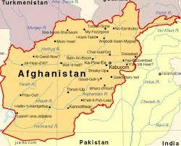
Historical Cultural Overview
What do these suggest about life for the average citizen?
The average life of a citizen is living in poverty and working every day of your life just to get by.

Slide 6
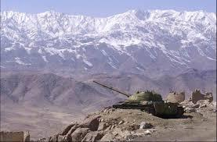
What do they suggest about Afghan national identity and value?
The word Afghan comes from the pashtun but was changed because of the civil wars in Afghanistan and their value disappeared [political independence, historical continuity, and the respect of Islam].

Slide 7
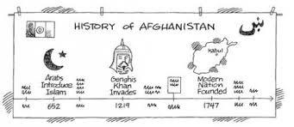
How does the country “basic information” affect it’s national identity?
An american’s basic information affects the national identity because and idea is already planted in peoples thought and so it affects the nation in general.

Slide 8
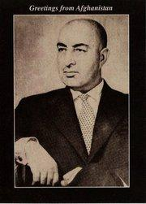
Mohammad Daud Khan
Mohammad Daud Khan, was an Afghan politician who overthrew the monarchy of Mohammad Zahir Shah in 1973 to establish Afghanistan as a republic.
He was born on July 18, 1909, Kabul, Afghanistan and was assassinated on April 27, 1978, Kabul.
Daud was known for his progressive policies, especially in relation to the rights of women, for initiating two five-year modernization plans.
He served as the country's first president from 1973 to 1978.

Slide 9
Why do most Afghans believe the Taliban tookover in 1933 is a good thing at first ?
Security and power
The Taliban restored security and conquered most of the country

Slide 10
1973 was a pivotal point in Afghanistan's history. Why ?
Maintaining that King Muhammad Zahir Shah had mishandled the economic crisis and in addition was stifling political reform, a group of young military officers deposed (July, 1973) the king and proclaimed a republic.
……. so basically a republic was formed Gen Mohammed Daoud Kahn overthrows the king because the government did not like his cousin Zahir Shah and takes control,outlaws monarchy and declares himself president.

Slide 11
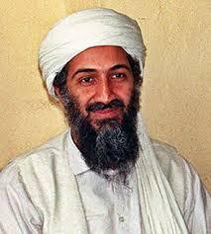
Why does Osama shift his focus from the Soviet Union to the U.S IN 1988?
Because he wanted ….
power and keep his power to form a country that is based from Islam.

