Slide 1
Faith and Religion
By: Adilene Ventura, Odalys Jimenez, Sirene Cano, Leslie Santiago, Michael Avina P3

Slide 2
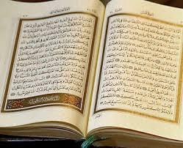
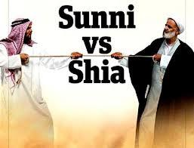
Basic Cultural Overview
Summary: Sunnis and Shiites view religion in different ways but have the same respect and authority to the Koran and the five pillars of Islam.
Sufism is an important form of expressing religiosity which is mostly represented by wandering beggars.
There are two kind of religious participants: scholars whose power is based on knowledge and saints whose power comes from the transmission of God’s blessing.
The Sunni’s have no formal clergy, but the Shiites have a religious hierarchy. With the wars, new religious leaders emerge having them question what was seen as tradition.
Some holy places are tombs of famous religious guides that become shrines to followers.
There are two main religious festivals, “The great feast of the victim” which is sacrifices to Abraham ending the annual pilgrimage to Mecca. Then there's “The small feast” which marks the end of fasting and a period in which you visit your relatives.
When it comes to burying the dead, some steps are taken. The dead are buried fast, families keep homes open for three days to accept condolences,then forty days after the death families and friends meet up at the grave to pray. After one year it is the end mark of mourning. If the funeral is not conducted correctly it is believed the dead come back to haunt the living.

Slide 3
Sunni V.S Shia
Shia
-------------------------------------------------------
1.2 million of the population follow Sunni
Most followed in Iraq and Iran
Sunni Muslims liked Abu Bakar as a leader of doing the prayers
200 million of the population follow Shia
Ali means master
Shia supported the belief that Muhammad Ali
Shia refused Muhammad's son-in-law which was (Abu Bakar)
Shia Muslims refer to people as a chosen leader (Muhammad Ali)
Allow temporary marriage

Slide 4
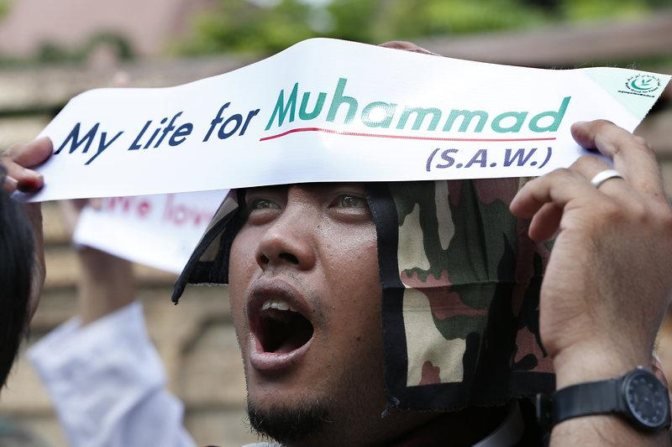
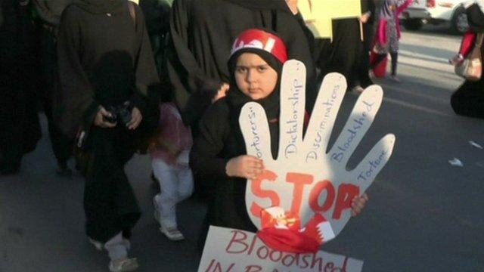
Pictures!!
Sunni
Shia

Slide 5
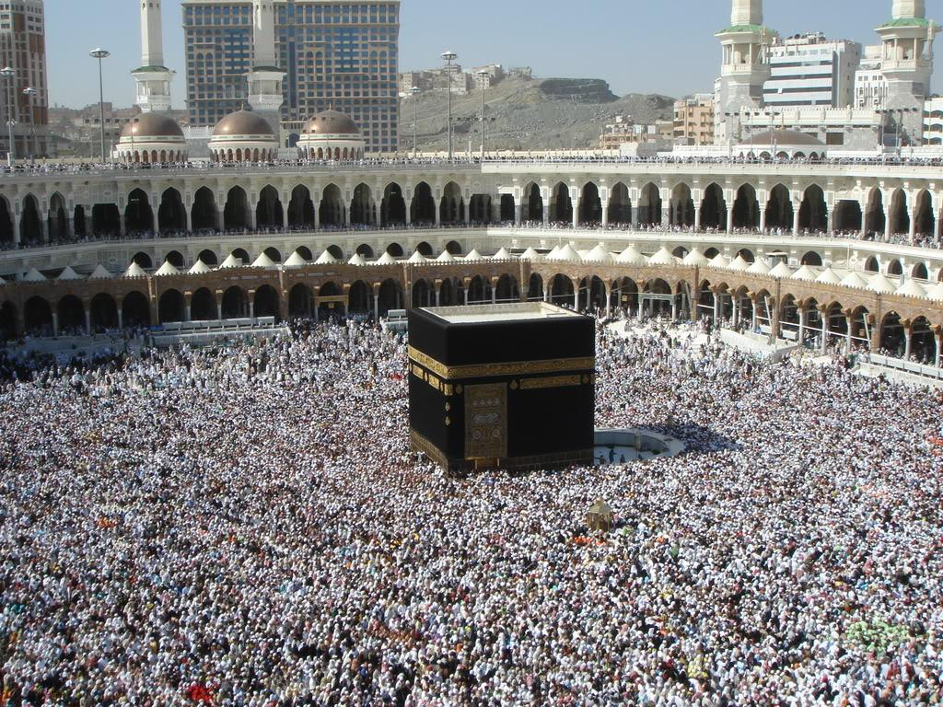
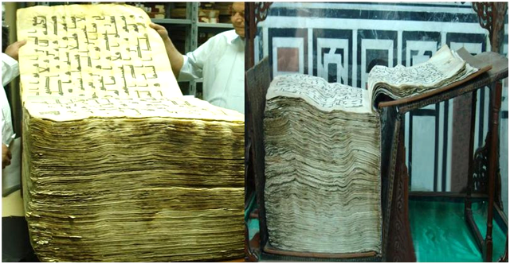
Overview of Islam
Islam
Is a fifth of the world’s population and is both a religion and a complete way life.
Religion of Muslims
is monotheistic which means they believe in only one god and no other god.
Muslims worship Muhammad rather than “Allah” which means God
a popular place where Muslims worship is the Ka’ba
Muhammad
was born in Makkah in the year 570 and was deeply religious nature and at age 40 he was the first to receive his first revelation from God that is why he is called the messenger of God
The Quran
a record of exact words from God through the Angel Gabriel to the Prophet Muhammad
it was the last revealed Word of God and the source of every Muslim’s faith and practice
Five Pillars of Islam
Faith- where only God and Muhammad are worthy of worship
Prayer- Muslims pray 5 times a day
Zakat- when Muslims are concerned for the needy
Self-Purification- in month of Ramadan, all Muslims fast from daylight till’ sundown
Pilgrimage- Muslims pilgrimage to the Hajj which is an obligation for those who are in physical condition

Slide 6
Overview of Islam
Muslim Family’s
Family is the foundation of Islamic society b/c peace and security offered by a stable family is greatly valued.
Muslim Women
Islam sees a woman as an individual in her own right also Islam men and women are expected to dress modest and dignified.
The Elderly
Caring for a parent in their most difficult time in Islam it is considered a honor and blessing.
View of Death
Muslims see present life as preparation for the next realm of existence.
About Food
Muslims are forbidden for consuming pig meat or any kind of intoxicating drink.
The Muslim World
The Muslim population in the world is around 1 billion and in the United States there are about 5 million.

Slide 7
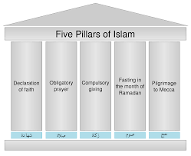
Through exploration of Islam
-islam is a monotheistic religion that was based on the prophet Muhammad in the 7th century A. D.
-it is the largest religion in the world.
-The Islamic practices had five pillars which were,
°Faith
•Prayer
•Fasting
•Pilgrimage
•alms
-Islamic followers are called Muslims.
-their bible is the Quran (Koran), Islam's sacred text.

Slide 8
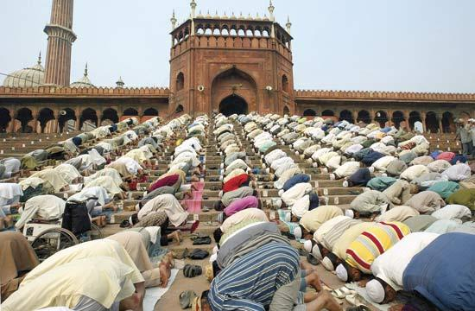
Prohibitions and Obligations of Islam
Muslims had a list of Prohibitions and Obligations they had to follow.
Some of the Prohibitions were:
2. To commit murder, adultery, and fornication.
10. To eat pork
12. To be a hypocrite
Obligations
3. Believe in an eternal life hereafter.
7. To pray daily
12. To provide children with a religious education.

Slide 9
Questions and Answers
1.What are the differences between Sunni vs. Shiite Islam?
The difference between both are political and not spiritual.
2.How is Islam intergal to Afghan culture?
Religion is the main intergal of Afghan culture because most of their lives revolve doing what their religion demand. 99% practice Islamic, 80% Sunni’s and 19% Shiites.
3.What are the basic tenets of Islam?
The basic tenets are the Five Pillars of Islam, which are Faith or belief in the Oneness of God and the finality of the prophethood of Muhammad, establishment of the daily prayers, concern for and almsgiving to the needy, self-purification through fasting, and the pilgrimage to Makkah for those who are able too.
4.What other religions have similar beliefs?
The other religions that have similar beliefs are the Christians and the Muslims.
5.Why do you think these religions, if they are so similar, seem to have difficulty getting along?
I think these religions that have similar beliefs, but don’t get along because of the small differences between each others religion. Both think they are better than the other, which causes them to clash.

