Slide 1
Afghan Daily Life
By: Christian Ramirez, Joshua Trujillo, George Gomez, Destiny Galindo, Omar Cisneros, and Joseline Amado

Slide 2
Traditional Afghanistan Clothing
A traditional male dress is called a qmis which is a loose-fitting shirt that reaches to the knees. A vest is usually worn over the shirt.With leather shoes.Long strips of cotton cloth are wrapped around the head although leaving the forehead uncovered because it is touched when praying.
Women traditionally wear baggy black or colored trousers a long shirt belted with a sash as well as a length of cotton over their head.

Slide 3
Afghan Food
Its food is a fusion of its neighbors and their own. Its food is influenced by Indian spices and they prefer their food not too spicy or hot.
Afghan Specials
Qabli Pulao is a dish with steamed rice and served with lamb
They consume three types of bread which are Naan, Obi Naan, and Lavash
They mainly eat non-vegetarian dishes and usually don’t use cutlery, which is part of their culture and it represents them. Instead of a spoon they use nan (a type of bread). The Afghans respect their guest and try to serve them the best foods possible.

Slide 4
Clothing’s Translation to Cultural Position
One of the dressing laws is that male and female guests do not mix in the same rooms
Women can not wear white or bare skin dresses for their wedding
under a law proposed by the justice ministry and soon to be considered by Karzai’s cabinet,”garments contrary to Islamic sharia”

Slide 5
Afghanistan Economy
The Afghan economy is predominantly agricultural, although only 12% of its land is arable and only 6% has been cultivated.
Last year’s GDP was only 1,100 per capita.
Much of the arable land in Afghanistan was damaged in the 1980’s and 90’s by warfare.
Currently, 35% of the Afghanistan population is unemployed and 36% of the population live under the national poverty line.
Some problems that the Afghan economy has are that much of the land’s natural resources are untapped and that much of its agricultural land that is actually arable was damaged by warfare.
The main exports are various fruits and plants, as well as opium, which is the source from where drugs like heroin are produced.

Slide 6
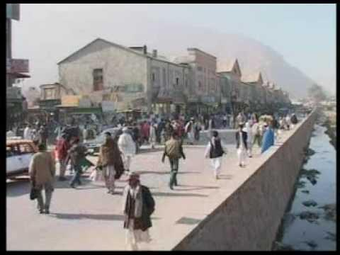
Video

