Slide 1
Women in Society
by:
Alyx Mercado, Crystal Palacios and Samantha Cabrera

Slide 2
How have things change/stayed the same since the Taliban lost power?
When the Taliban lost power very few women had an opportunity to go to school, good health care, and employment.
Women remained fearful of the armed Americans who were all over the country.
Women still have to listen to the demands of the males because males didn’t want to give women independence.
There are reports of beatings, rape, and kidnappings that have increased.
If women make multiple reports of being sexually insulted they will be automatically imprisoned.

Slide 3
Explore how women’s role in society has developed in the last forty years?
Afghan women have proved to the world that if you want something you need to work hard and never give up. However, there is still much corruption in Afghanistan. Afghan women still struggle for finding peace, freedom, democracy and women's rights in fundamentalism. Fortunately, there are organizations like RAWA that help support and help fight for Afghan women rights. Over the years Afghan women have been through many harsh conditions and unfortunate events and are discriminated for being of the female gender. Woman have been raped, abused, and tortured in Afghanistan.

Slide 4
What challenges to modern Afghan women encounter?
-having an arranged marriage
-not dressing the way they’d like
-being underestimated to do the same job as men
-having the image as a “household wife”
-subjected to having an input for life decisions

Slide 5
Afghanistan's Women after 'Liberation'
http://www.rawa.org/nanji.htm
In the article there was a convention happening in Afghanistan in the Loya Jirga. It was to discuss about the new constitution. A woman name Joya was brave enough to voice the actions that were occurring. Some of the actions she was referring to was getting acid thrown into womens faces, breasts chopped off, and other horrendous actions. In Taliban women have got more opportunities, but not all of of them women. Some organizations are trying to help the women get more equality rights. The woman in Afghanistan will begin to talk once the country is strong itself.

Slide 6
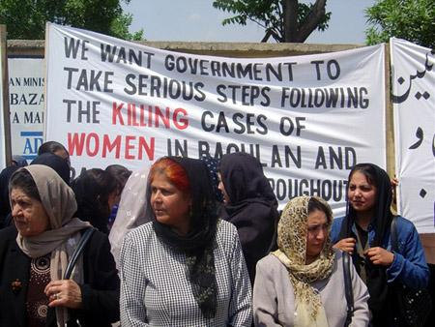

Slide 7
Afghan Women
http://ngm.nationalgeographic.com/2010/12/afghan-women/rubin-text
According to National Geographic in Afghanistan, it is considered normal to brutalize, abuse, discriminate women. Women are being deprived from school and are expected to do traditional “women actions”. Women are being traumatized everyday by men every day in Afghanistan. Bibi Aisha was abused by her husband he slashed her nose and ears as punishment for running away. Sahera Sharif stood up to her father by locking herself in a closet until her father agreed to let her attend school.

Slide 8
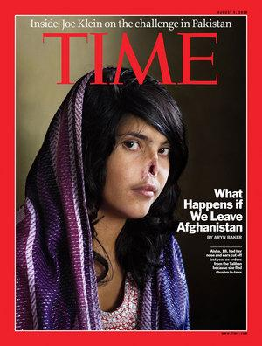
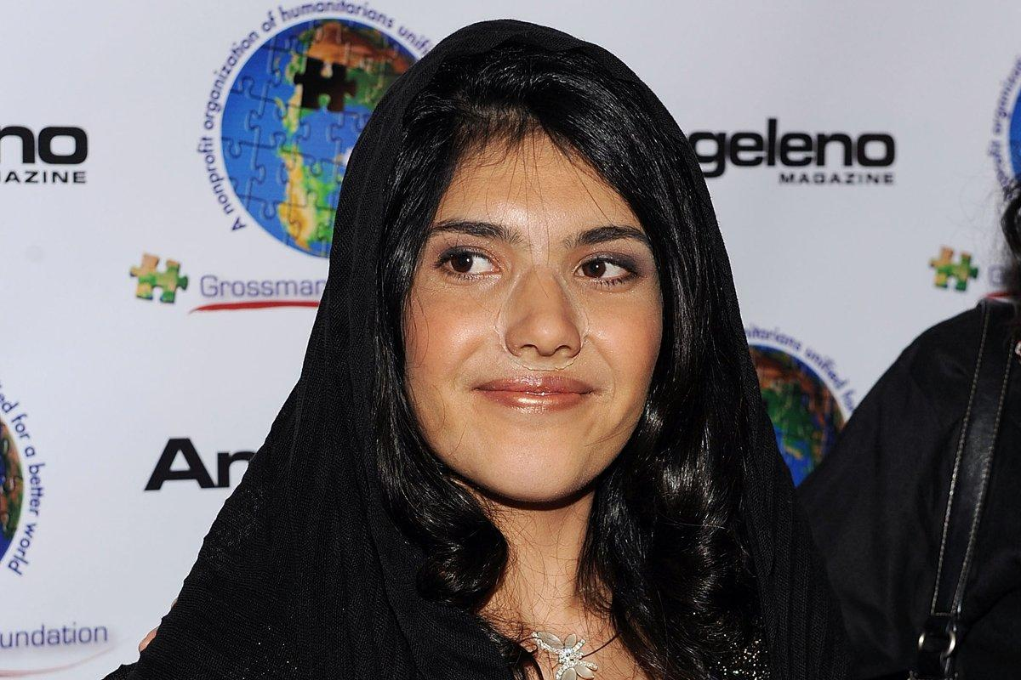
Bibi Aisha

Slide 9
Afghan Women Fear for the Future
http://www.theguardian.com/lifeandstyle/2011/feb/04/afghan-women-fears-for-future
The article, “Afghan women fear for the future”, describes the difficulties that women struggle through when trying to succeed more than average day lifestyles. The men of their culture see it as “male dominance”. Samira Hamidi, director of the Afghan Women's Network, states that rebels still torture people in their everyday life and do things such as kill children, put poison in the food of school girls, and throw acid in the face of school girls.

Slide 10
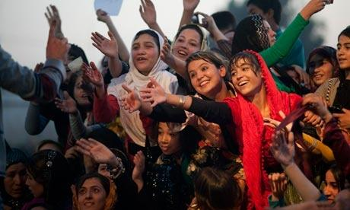
women in Mazar-i-Sharif, Afghanistan

Slide 11
Afghan Women Soar to New Heights
http://www.nato.int/cps/en/natolive/news_71148.htm
Fortunately not all Afghan women go through such horrible conditions some actually are very successful and have a beautiful life. These Afghan women have proved to all the people that have ever doubted them that just because they are women does not mean they are any less then a man. These women have “soared to new heights” and protect their nation in the Air Force.

Slide 12
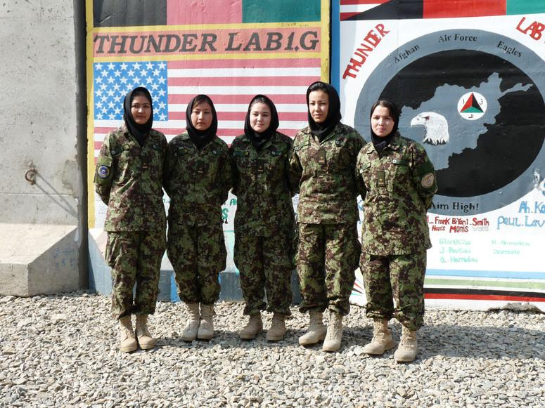

Slide 13
