Slide 1
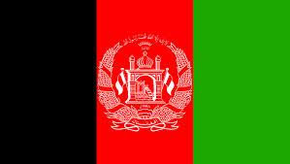
Afghanistan Cultural Context:Religion and Faith
By: Kiara Ramirez, Rebeca Madrid, Christian Aquino, Edgar Vidal, Jakob Salazar

Slide 2
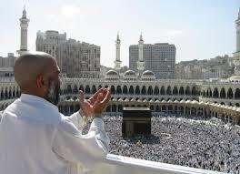
Difference between Shia and Sunni
When Muhammad (original leader of the Muslims) died the Shia and the Sunni split up into two groups.
Sunni wanted general election by the followers of the community while Shia wanted the power to stay in Muhammad’s family. The main difference is not in religion but in the struggle for power.

Slide 3
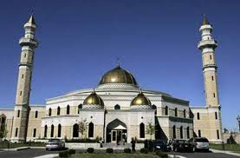
How is Islam Integral to Afghan Cultural
Islam is practised by the majority of Afghan is and governs much of their personal, political, economic, and legal lives.
The family is sacred and as such, is protected. As a result, probing about the family is not advised.

Slide 4
Five pillars of Islam
Faith or belief in the Oneness of God (Shahada)
Daily prayers (Salah)
Caring for the needy (Zakah/Zakat)
Self-Purification through fasting (Sawm)
The pilgrimage to Makkah (Haji)

Slide 5
Similarities of Judaism, Christianity, and Islam
Monotheistic- belief in one god
God is the origin and source of all that exists
All believe that human beings are the highest creatures on earth
Believe the duty of people is to read or listen to God’s Holy Writings
All three religions foster modesty, moderation, and honest work.

Slide 6
Why so much hostility?
Both Christianity and Islam accuse accuse Judaism of stubbornly refusing to accept later revelations that modify and update its original truths.
Islam and Judaism look down on Christianity because they believe that Jesus was a form of god.
Both Judaism and Christianity argue that God did not give a special, final revelation to Muhammad.
They all believe in afterlife
They all share they all testament

Slide 7
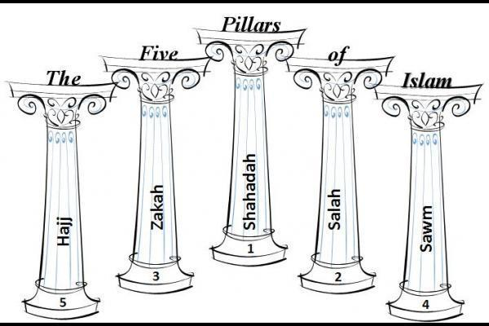
ISLAM

